Slide 1


Introduction To Computer Science
Dr Abdullah Nabil
Part 3

Slide 2

Intro to Computer Science
⬡ Data types & Variables.
⬡ Relational & Arithmetic & Logical Operations.
⬡ expression vs statement.
⬡ Hands-on Programming with Python.
⬡ Anaconda & Jupyter.
Session outline :

Slide 3
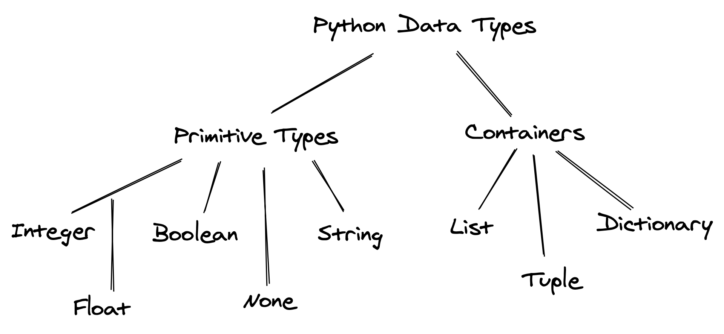
Data types :
Intro to Computer Science
Notes:
Boolean

Slide 4
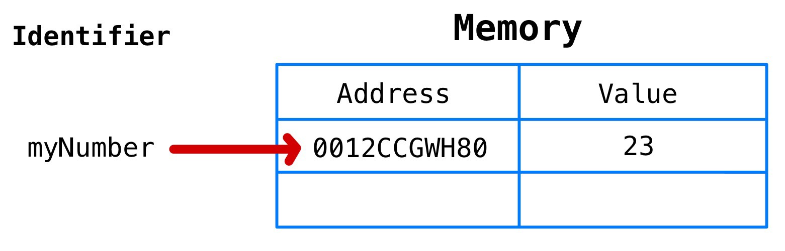
Variables: Are names given to computer memory locations in order to store data in a program.
Intro to Computer Science

Slide 5
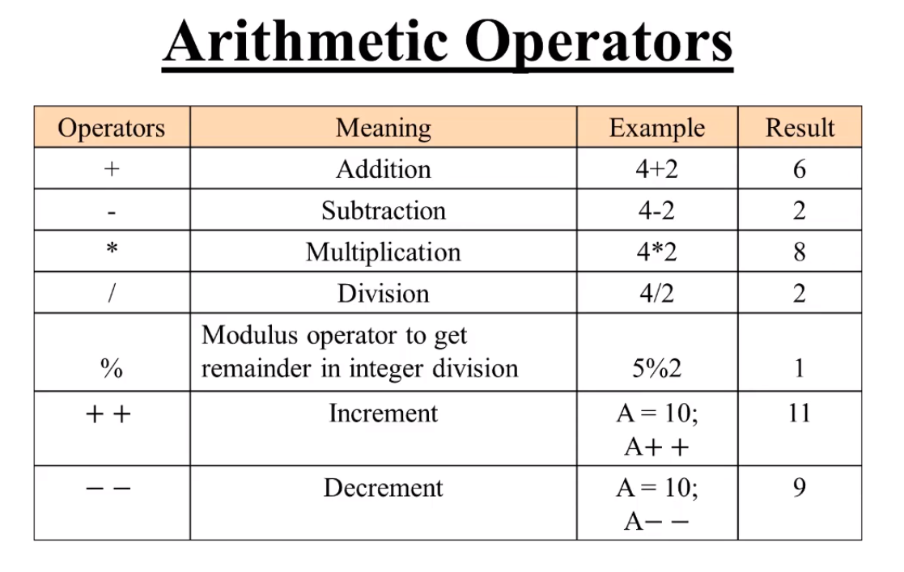
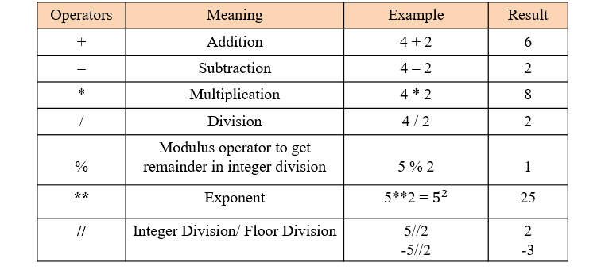
Arithmetic operations: branch of mathematics specified by combining an equation
Intro to Computer Science

Slide 6
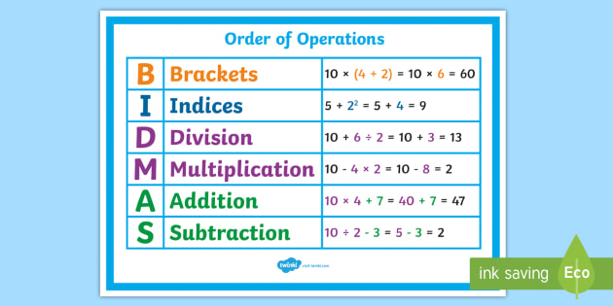
Arithmetic operations order
Intro to Computer Science

Slide 7
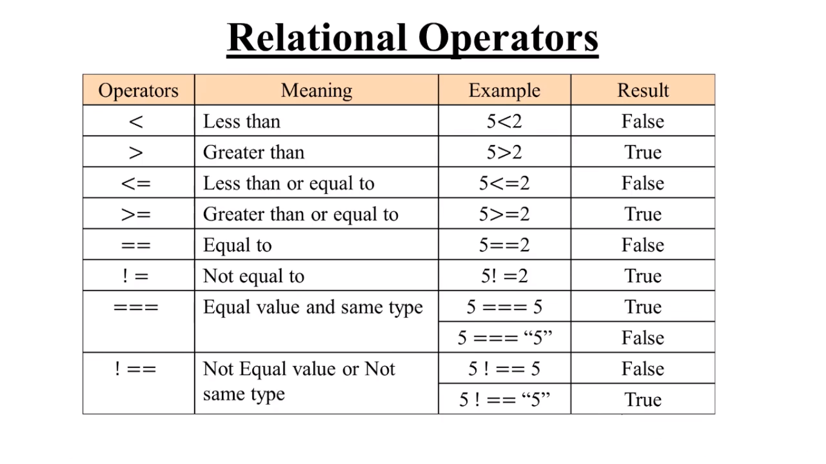
Relational operations: operator that tests or defines some kind of relation between two entities.
Intro to Computer Science

Slide 8
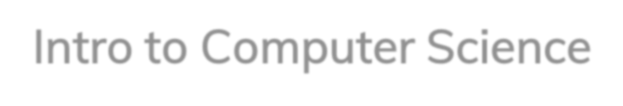
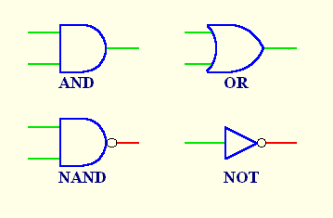
Logical Operator:
Intro to Computer Science
And
OR
Not

Slide 9
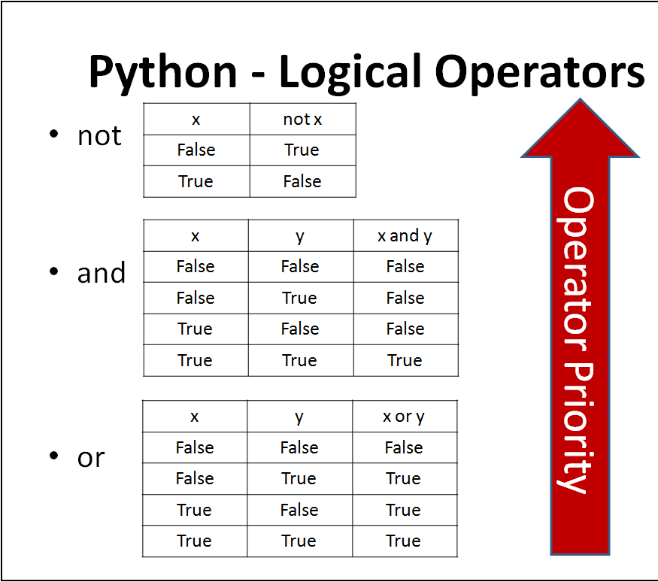
Logical Operator:
Intro to Computer Science
And
OR
Not

Slide 10
Intro to Computer Science
Logical Operator
NOT (!)
AND (&)
OR (|)
Logical operators are used to combine several conditions into one compound condition
The outcome of condition is True or False
Operators above are listed in order of precedence
Not is evaluated first, then AND, then OR
The relational operators have higher precedence that the logical operators
It is usually best to include the extra parentheses

Slide 11
Intro to Computer Science
Logical Operators: Examples
IF (x = 32) AND (y = 7) THEN
sumXY = x + y
IF (letter = 'A') OR (letter = 'E') THEN
DISPLAY “Vowel”
IF NOT (letter = 'A') THEN
DISPLAY “Not letter A”

Slide 12
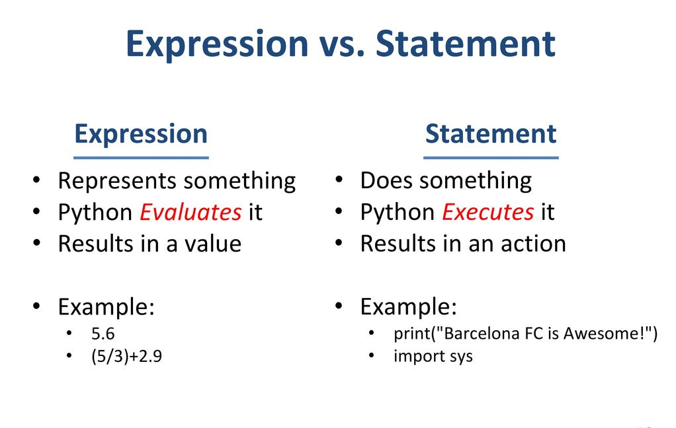
• Statement: - is a complete line of code that performs some action. - can only be combined “vertically” by writing one after another, or with block constructs. • Expression: - is any section of the code that evaluates to a value. - can be combined “horizontally” into larger expressions using operators.
Intro to Computer Science

Slide 13

Intro to Computer Science
What is comments?
- Comments can be used to explain Python code..

Slide 14
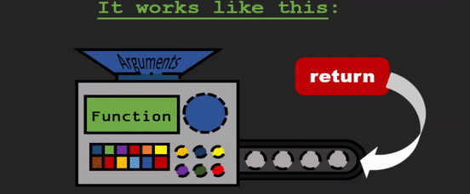
What is a function ? - A function is a named section of a code that performs a specific task. This typically involves taking some input, manipulating the input and returning an output
Intro to Computer Science

Slide 15
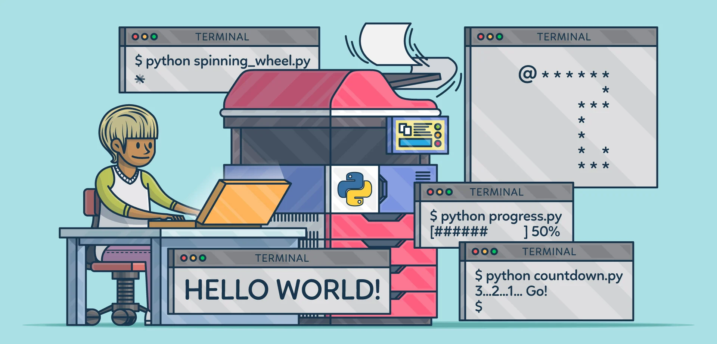
Intro to Computer Science
An output is data that a computer sends.

Slide 16
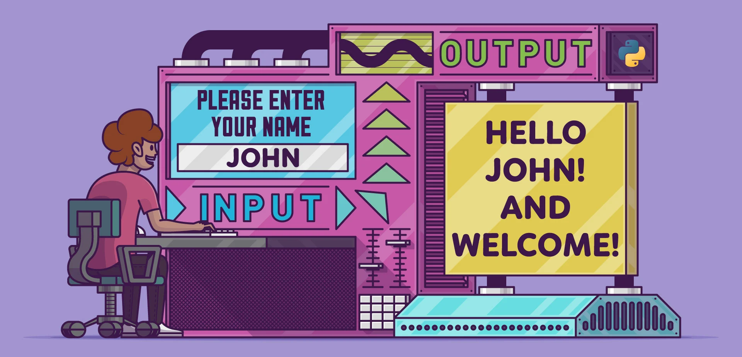
Intro to Computer Science
An input is data that a computer receives.

Slide 17
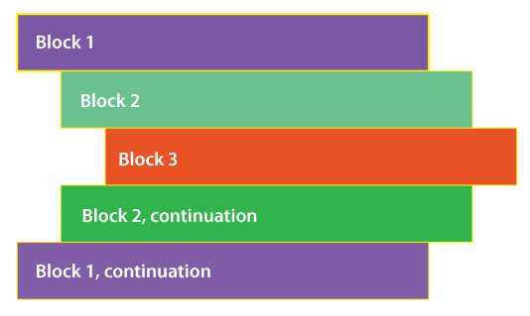
Intro to Computer Science
Indentation :
- the leading whitespace ( spaces and tabs ) before any statement in python.
- Python treats the statements that have the same indentation level (statements that have equal no of whitespaces before them) as a single block of code.

Slide 18
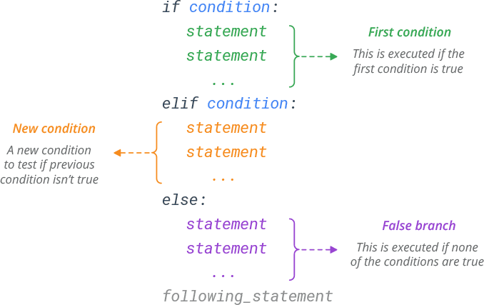
Intro to Computer Science
What is in an if statement?
- The IF statement is a decision-making statement that guides a program to make decisions based on specified criteria.

Slide 19
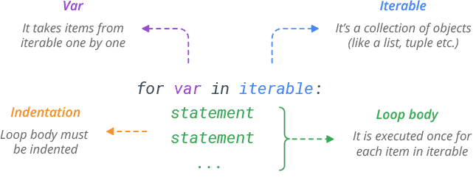
Intro to Computer Science
What is for loop?
- A "For" Loop is used to repeat a specific block of code a known number of times.

Slide 20
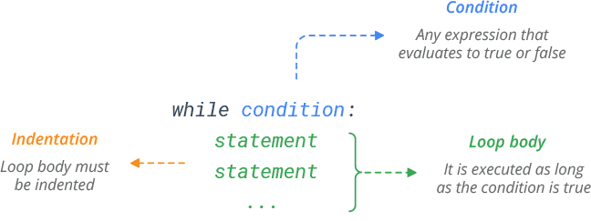
Intro to Computer Science
What is while loop?
- while loop is a control flow statement that allows code to be executed repeatedly based on a given Boolean.

Slide 21

Jupyter: Notebook provides you with an easy-to-use, interactive data science environment across many programming languages like python
Intro to Computer Science

Slide 22
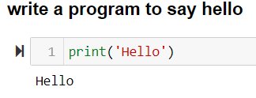
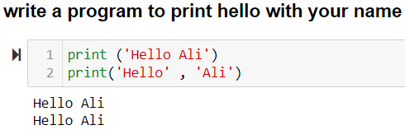
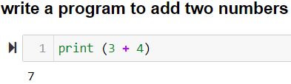
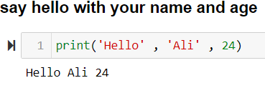
_{Introduction to Python}
Intro to Computer Science

Slide 23
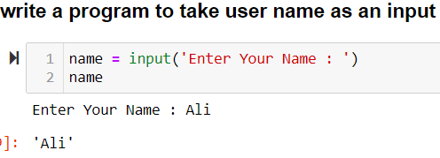
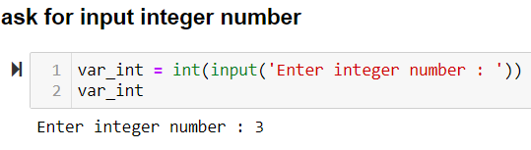
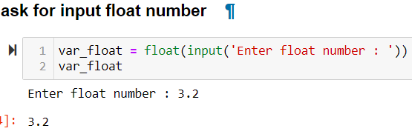
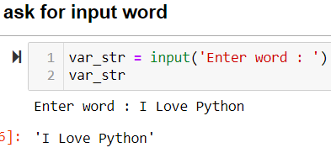
_{Introduction to Python}
Intro to Computer Science

Slide 24
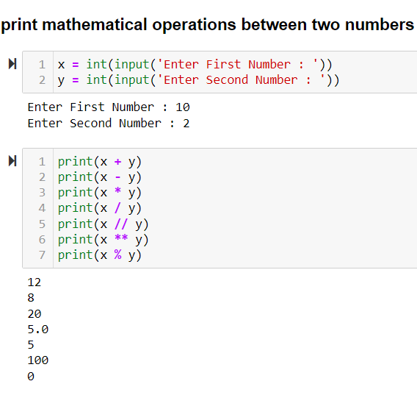
_{Introduction to Python}
Intro to Computer Science

Slide 25
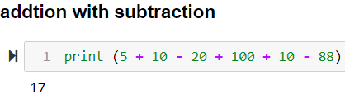
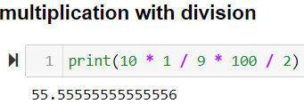
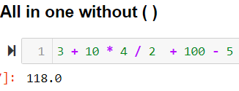
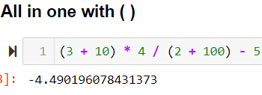
_{Introduction to Python}
Intro to Computer Science

Slide 26
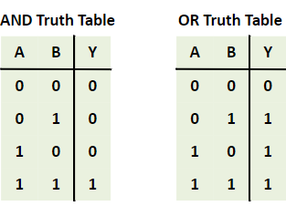
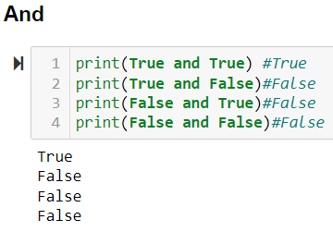
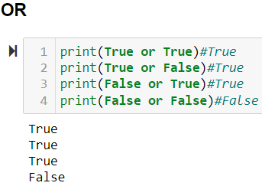
_{Introduction to Python}
Intro to Computer Science

Slide 27
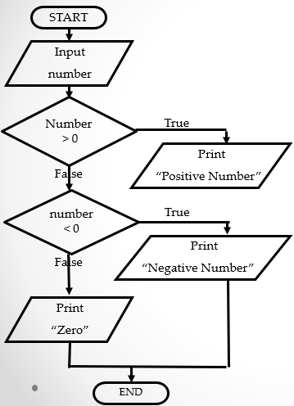
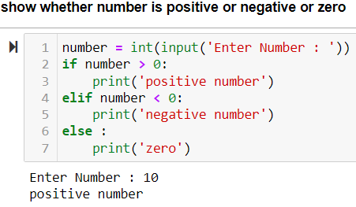
_{Introduction to Python}
Intro to Computer Science

Slide 28
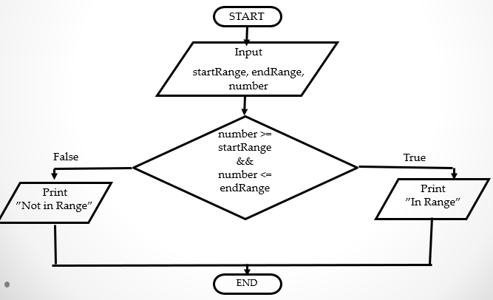
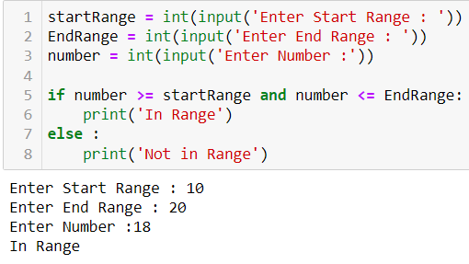
_{Introduction to Python}
Intro to Computer Science

Slide 29
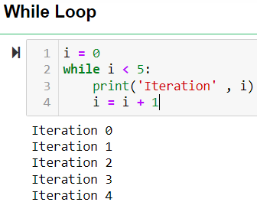
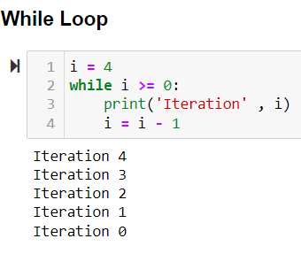
_{Introduction to Python}
Intro to Computer Science

Slide 30
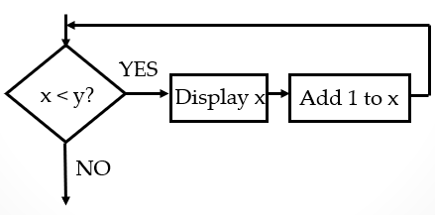
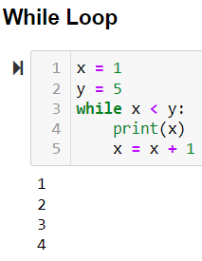
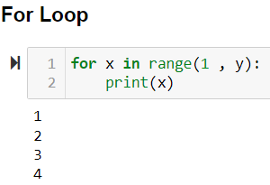
_{Introduction to Python}
Intro to Computer Science

Slide 31
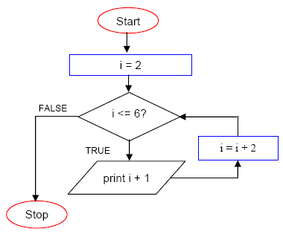
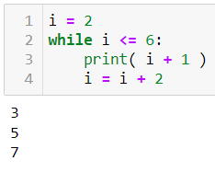
_{Introduction to Python}
Intro to Computer Science

Slide 32


Questions ?!

Slide 33
Thanks!

